Slide 1
Building Large Web Applications Using the ArcGIS API for JavaScript and Dojo toolkit

Slide 2
Welcome to Esri Training
Logistics
Daily schedule
Cell phones/messages
Class environment
Introductions
Name
Organization
Course expectations

Slide 3
Course goals
Taking Dojo knowledge to next level
Build web mapping application that are
Easley maintainable
Expandable
Reusable code
Target different platform

Slide 4

The difficulties

Slide 5

Why some hate JavaScript

Slide 6
Fixing JavaScript
We can fix JavaScript with writing more JavaScript
Dojo / JQuery ….

Slide 7
Course Mission
Our organization asked us to make a mobile version of StartupApplication
The new version should share the business functionality with the "desktop" version, so if we modify the application in the future, the modification will be on both versions.

Slide 8
Global Name Space
what is wrong with this
function myFunction()
{
output = 3;
}

Slide 9

Dojo lately joined the good side

Slide 10
From Dojo Docs
if you are about to access something in the global namespace STOP because you are doing something wrong

Slide 11
From Dojo Docs
If you find yourself typing dojo.* or dijit.* or dojox.*, something isn't right
It won’t work with 2.0

Slide 12
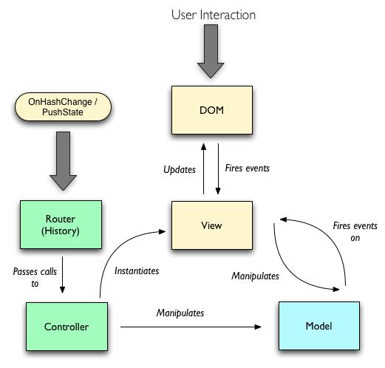
MVC (backbone as example)

Slide 13
The new defining module
define ([dependency list….], function (args) {
……
}

Slide 14
Exercise 1 Goals
Transfer old code to new AMD syntax
Learn all possible ways of adding modules:
Modules that run by itself.
Modules that define classes.
Modules that return objects

Slide 15
Exercise 2: Goals
Reuse modules
Learn ESRI template for mobile

Slide 16
Exercise 3: Goals
Learn what is wrong with the old way of wiring events.
Wiring events without dependencies

Slide 17
Exercise 4: Communicating between modules
Communicating between modules without dependencies
Usefulness of Defer for esri async calls
Use Topic / Aspect Oriented Programming

Slide 18
Exercise 5: Unit Test with DOH
Configure DOH to be used with esri library, and hosted locally or hosted by CDN.
Write a full unit test for a module
Examine other options with unit test.

Slide 19
Exercise 6: Adding Graph/Refactor
Use map for array: example grid
Similar to linq in .NET

